Slide 1
SOFTWIDGET
Voice-Assisted Commerce application
Proposal
March 30, 2019

Slide 2
Agenda
The Idea - Voice Assistant Integration
Solution – Alexa
Approach – Innovation Lab
Demonstrate Alexa Skill
Development Practices
Tech Stack
Alexa Dev Console Configuration
GitHub Practices
Unit Test
Deployment Practices
Questions

Slide 3
The Idea- Voice Assistant Integration
Before jumping into details on the proposed path forward, it’s important to level-set on the actual idea
Growing sales of Amazon Echo and Google Home suggest voice assistants aren’t a novelty item or fad. Currently, 32% of consumers own one of these devices, and that number is expected to grow, given 79% of smart-speaker sales occur in the fourth quarter of 2018, according to a survey by Adobe Analytics.
50% of voice-controlled device owners have made a purchase with one in the past year.
Voice searches are replacing traditional searches, And if you’re not optimizing for them, you’re going to miss out on a lot of Google traffic.
Three years from now, 40% of consumers will shop with the help of these devices, spending 18% of their total shopping budgets in the process, Capgemini predicts.

Slide 4
Solution - Alexa
Why Alexa - How You Get People To Buy Things Via Alexa
Amazon’s Echo smart devices are leaders in the smart speaker market. It also leads when it comes to the number of ways you can use it. At last count, Amazon said that Alexa comes with more than 40,000 skills. As an online retailer, Alexa can help you with many tasks throughout the day. This includes tracking sales, organizing tasks, getting industry news, and more.
For Example, if you sell on Amazon marketplace(available via prime) than alexa will recommend your products. Amazon uses Amazon’s Choice makes product recommendations based on availability, price, popularity, ratings, reviews, shipping speed, and other factors. Another example is Shopify - If you are using Shopify platform than you can use the Shopify Alexa skill to get important information about your store.
Custom Skill – Best thing Alexa skill offer retailers the opportunity to open new selling channel by creating custom skill. Cybergroup have good experience working with companies to create skills for business purposes, to become more efficient, and even increase sales. Cybergroup is going to use the innovation lab to cerate quick POC to show how you can create custom skill to place your order along with couple of other features.

Slide 5
Approach – Innovation Lab
Cyber Group prefers taking the “Innovation Lab” track for the following reasons:
Our team at Innovation Lab is constantly working on exploring and learning new techs/products.
Properly sets expectations by demonstrating quick POC
This will also give you an idea about standards we follow through developing an application.

Slide 6
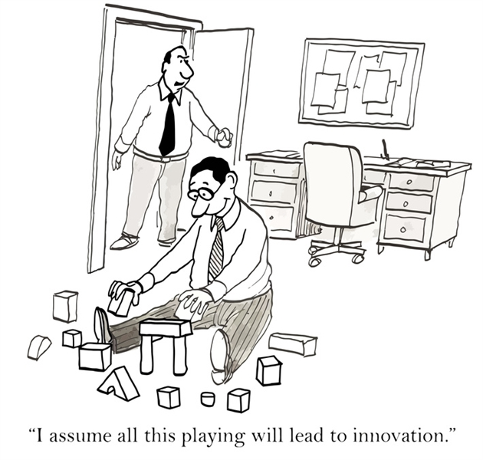
Demonstrate Alexa Skill

Slide 7
Development Practices
Tech Stack
Alexa Dev Console Configuration
GitHub Practices
Unit Test
Deployment Practices

Slide 8
QUESTIONS

